Slide 1
SEVA: SYSTEM FOR EXTENSIVE VACCINE ADMINISTRATION
Team – Data Dojo
Siddharth Gargava (002771533)
Ankuran Chattoraj (002776562)
Kudayattutharayil Midhun Mohan (002951090)
Sakshi Shetty (002776657)

Slide 2
TEAM CONTRIBUTIONS
Siddharth Gargava (002771533): DDL – Table Creations, Onboarding packages and procedures, Users/Security, Exception Handling
Ankuran Chattoraj (002776562): Deletion packages and procedures, Users/Security, Function, Exception Handling
Sakshi Shetty (002776657): Index, Insertions, Function, Procedure – Login Check
Kudayattutharayil Midhun Mohan (002951090): Views, Triggers, Reports, Sequence, Function, Audit table

Slide 3


PROBLEM STATEMENT
As the world faced the devastating effects of Covid-19, one key-way emerged to combat Covid was through the vaccine.
Vaccinations had to be administered to recipients by medical workers in a clinic/hospital. However, this entire process of vaccine administration became a challenge. An effective solution was required to streamline the mechanisms of recipients registering and billing; medical workers administering the vaccine in a clinic/hospital.

Slide 4
OBJECTIVES
The key objectives include:
Design a system that will streamline the process of recording vaccine distribution in a centralized, real time accessible manner
Recording vaccinated patients in hospitals/vaccination centers
Simplifying registration process for folks to receive vaccination
Extensive database storing vaccine and vaccination-related information including their pricing, and expiration dates
Robust billing process to smoothen vaccine-related transactions
Identifying medical workers in each vaccine disbursal for transparency and accountability

Slide 5
PROPOSED SOLUTION
The proposed solution is to create a system that manages COVID Vaccination record data quickly, securely, and effectively using a relational database. Through a single secure portal, patients could register for a particular COVID vaccine, pay their bill, Hospitals could stock their supplies, a medical worker can administer the vaccine and records can be maintained of the same. By using this platform, the patient will be in direct digital contact with the vaccination management setup, eliminating the need for multiple points of contact for vaccine registrations, slot availability, prior vaccinations details etc. thereby enabling quicker care for the client.
The vaccine management system is as follows:
The client can register for the vaccine with basic information, including their name, date of birth, email address, phone number, and address.
Hospital Admin enter the data of medical workers who’ll be carrying out vaccinations
The Medical Worker uses the vaccine of a specific type and administers the dose
The record of the administered vaccine is updated on the vaccine record table by medical worker hence completing the vaccine administration cycle.
App Admin is responsible for maintaining details about different participating hospitals and vaccination shots available

Slide 6
CONCEPTS EXECUTED
01
STORED PROCEDURES
05
VIEWS
06
TRIGGERS
02
FUNCTIONS
07
SEQUENCE
03
PACKAGES
08
EXCEPTION HANDLING
04
GRANTS
09
REPORTS

Slide 7
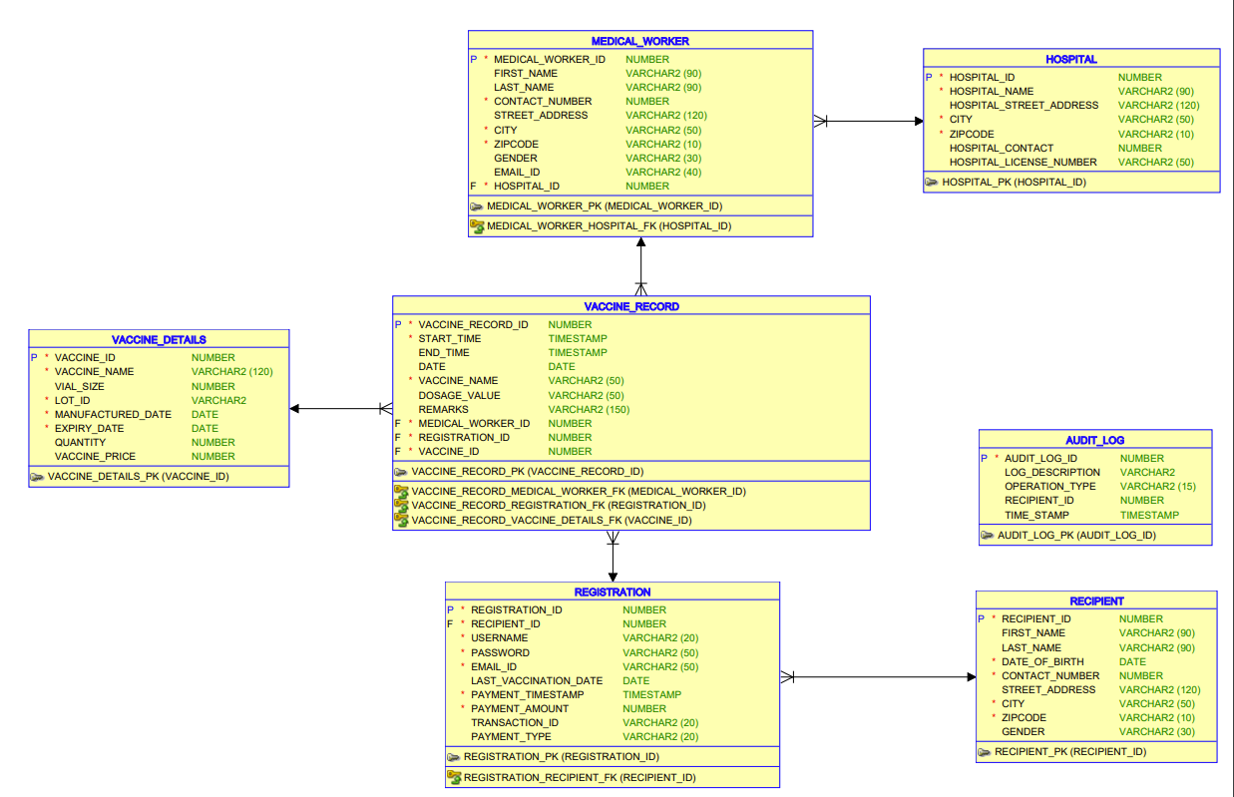
ERD

Slide 8
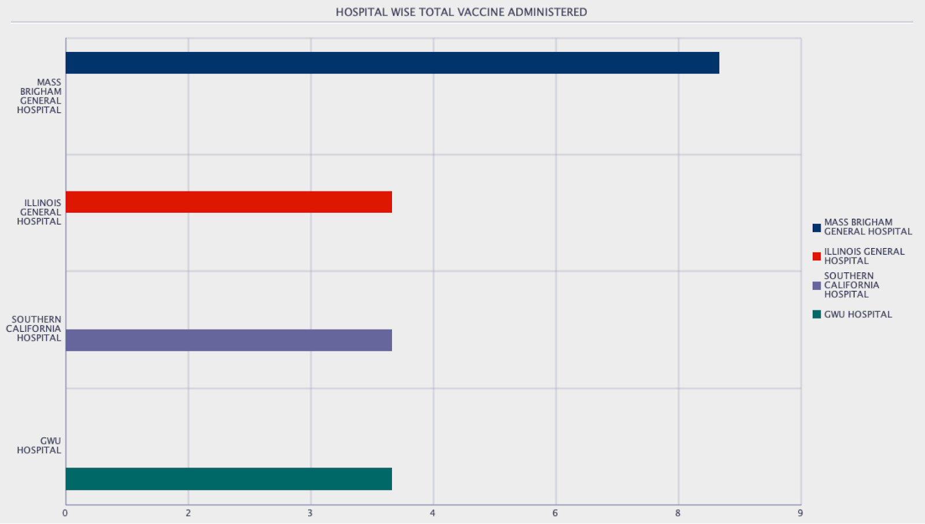
REPORTS
Total number of vaccines administered by Hospital.

Slide 9
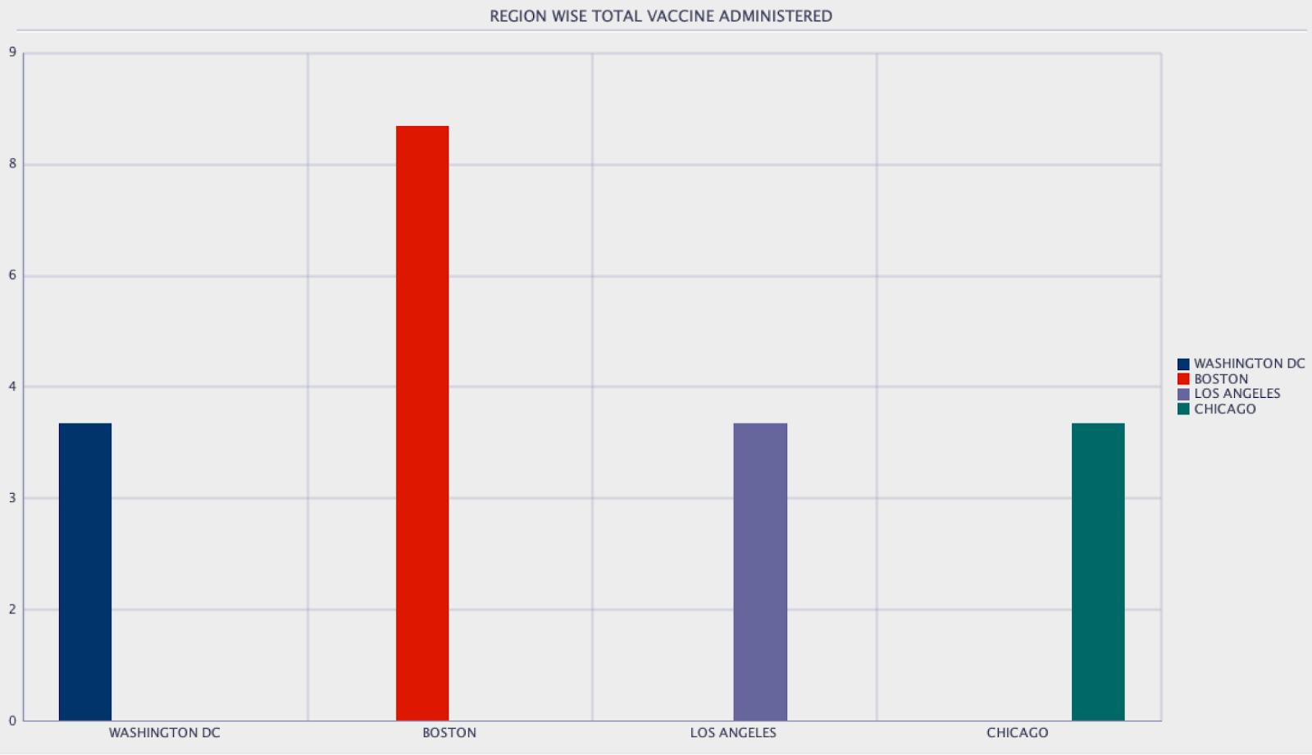
REPORTS
Total number of vaccines administered by region.

Slide 10
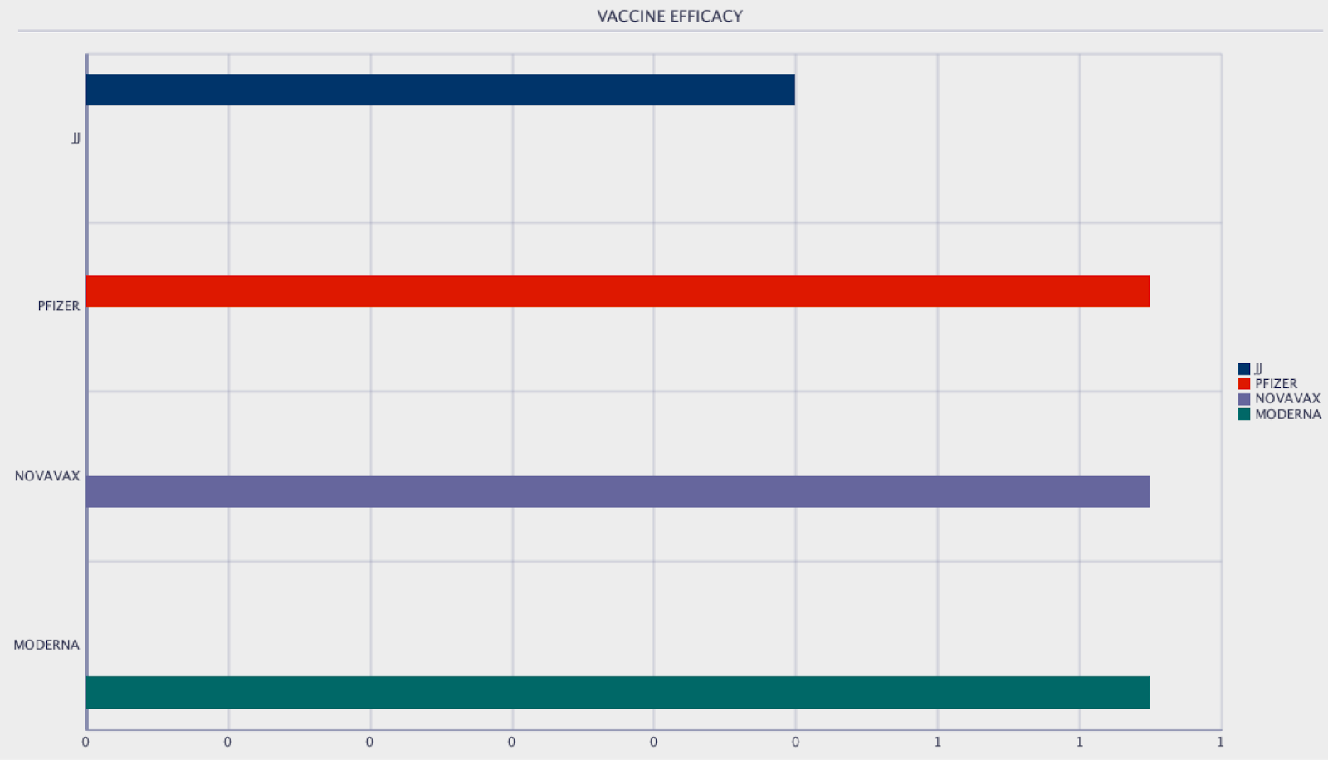
REPORTS
Vaccine Efficacy, Effectiveness of each vaccine.

Slide 11

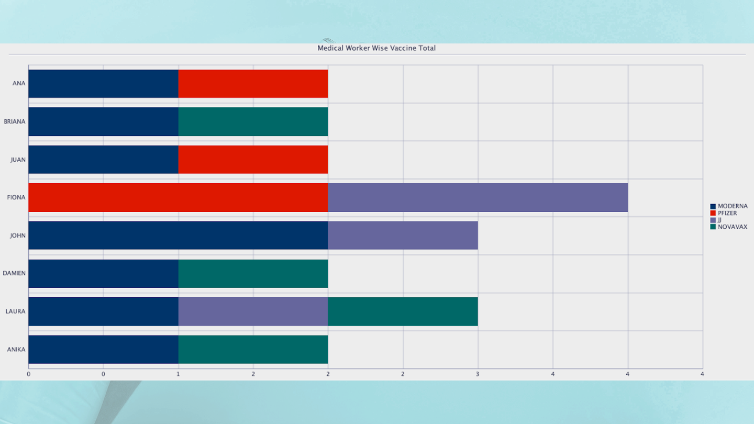
REPORTS
Total number of vaccines administered by each Medical Worker

Slide 12
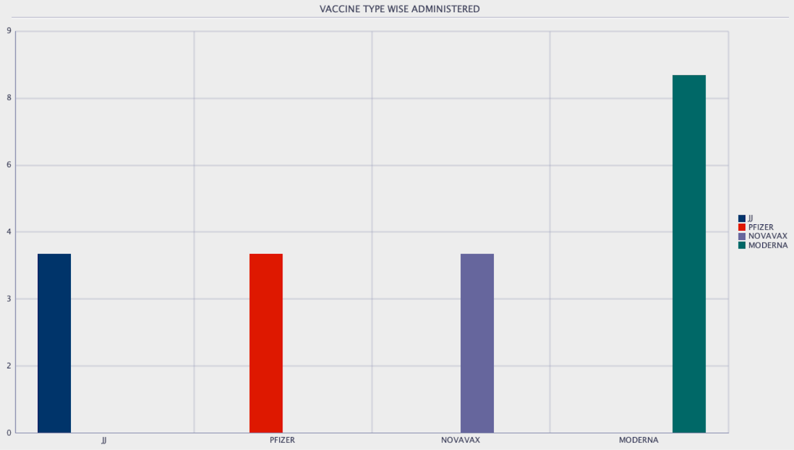
REPORTS
Total number of vaccines administered by each vaccine type

Slide 13
THANKS!

